Slide 1
Bacterial Species Recognition

Slide 2
Team Members
Jayasurya J
Jaiswathika J
Santhosh
Greesh Chandhar Sahu

Slide 3
Content
World of Microbiology
Bacteria
Introduction to AI
Technology used
Accuracy and Model
Previous models
Demo

Slide 4
World of Microbiology
Microbiology is the study of microscopic organisms, such as bacteria, viruses, archaea, fungi and protozoa. This discipline includes fundamental research on the biochemistry, physiology, cell biology, ecology, evolution and clinical aspects of microorganisms, including the host response to these agents

Slide 5
Bacteria
Bacteria are microscopic, single-celled organisms that thrive in diverse environments. These organisms can live in soil, the ocean and inside the human gut.

Slide 6
Why Bacteria?
Bacteria has more usefulness in the human life . Most of the bacterial species are helping our day to day life even without our knowledge.
In medical industry it has huge value.
Recognition of the species will be highly valuable.

Slide 7
Field of Artificial intelligence
In computer science, artificial intelligence (AI), sometimes called machine intelligence, is intelligence demonstrated by machines, in contrast to the natural intelligence displayed by humans and animals.

Slide 8
Technology used
Convolutional Neural Network(CNN)
Tensorflow
Keras
Numpy
Pandas

Slide 9
Technology used
Web Development
HTML
CSS
Js
Bootstrap
Flask

Slide 10
Computer vision
The main moto of this idea is to reduce the human effect in identification of Bacterial Species with the help of computer vision

Slide 11
Training and Accuracy
Activation function
Max Pooling
Accuracy
Deployment

Slide 12
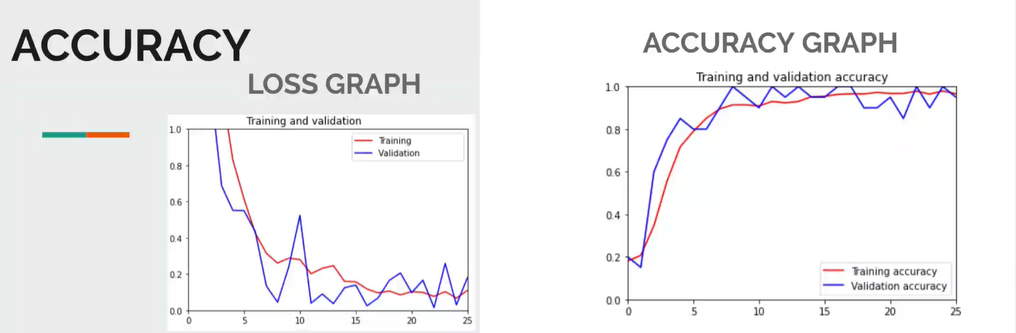

Slide 13
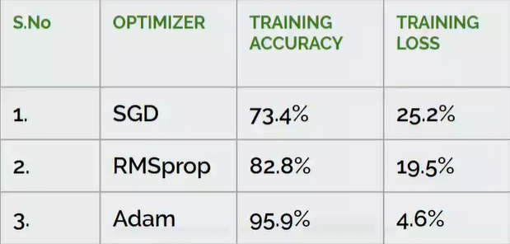
Optimizer used

Slide 14
demo

Slide 15

thank you

